Slide 1
Three.js Tutorials Part 1 (0-9)
References:
http://threejs.org/examples/

Slide 2
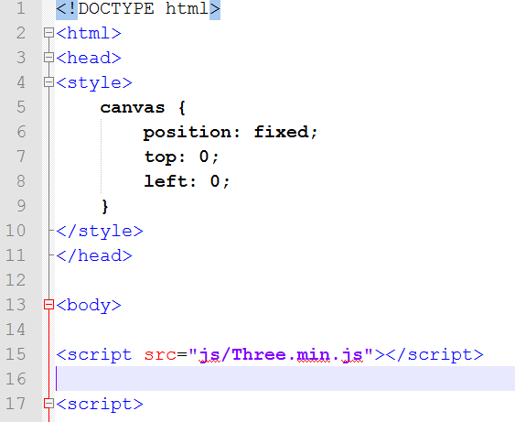
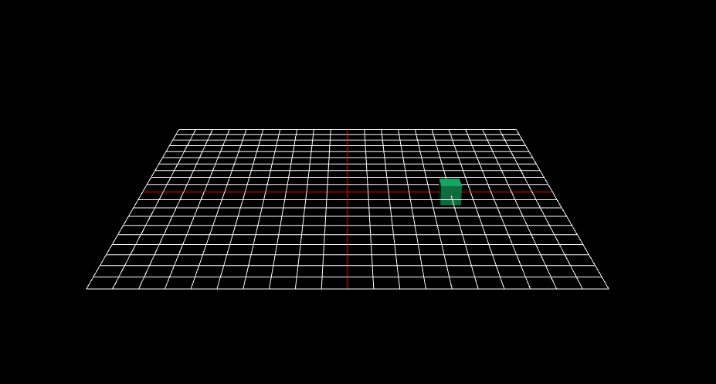
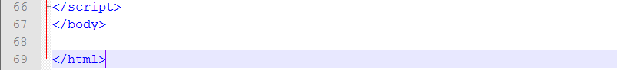
Blank HTML Template
min version is smaller (remove all spaces) and faster to load
Make sure you have the lastest version (r69)
// script …..

Slide 3
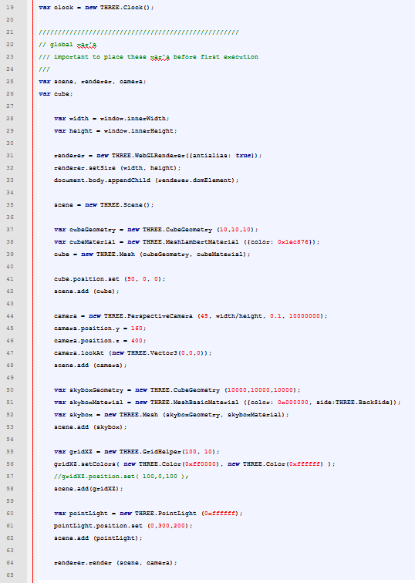
Script (Tuts 0)
Global variables
F12 to bring up Javascript console
Version 0 is a plain javascript.
No use of functions yet
Scene set up
function init()
Render
function animate()

Slide 4
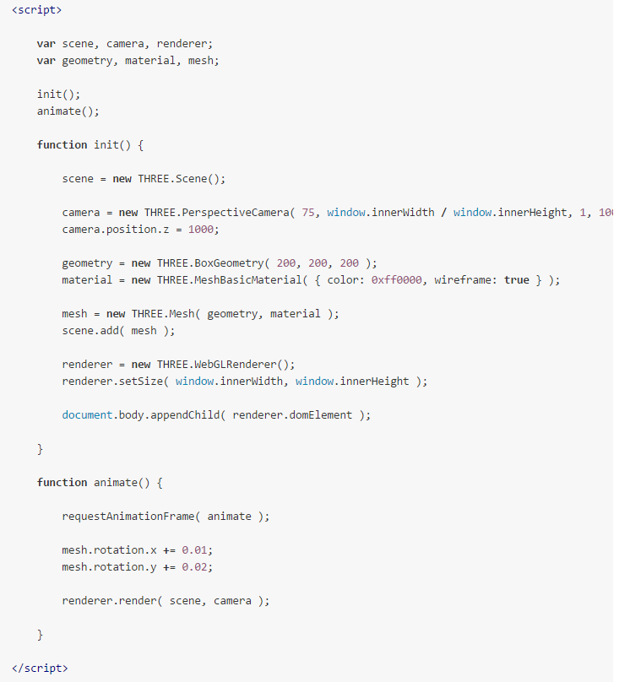
Style suggestion (from mrdoob’s github)

Slide 5
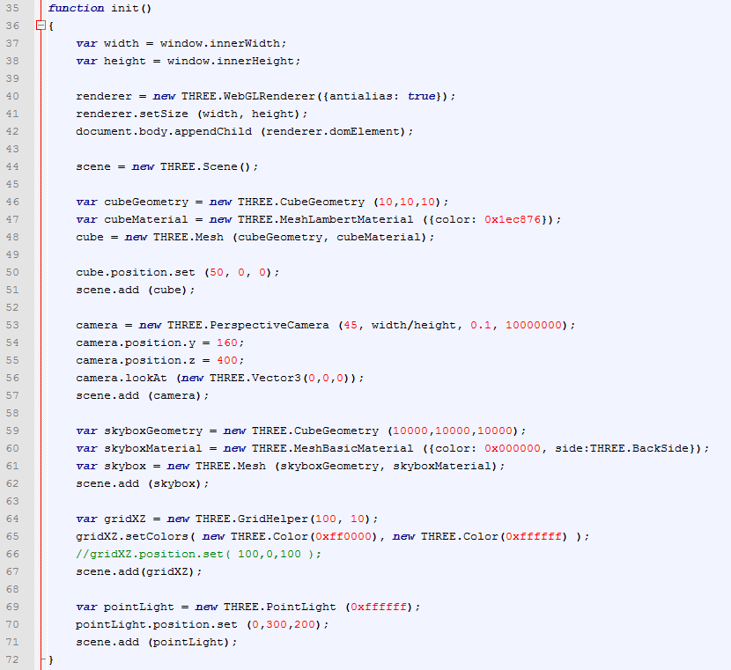
Script (Tuts 1)
CubeGeometry has been changed to BoxGeometry

Slide 6
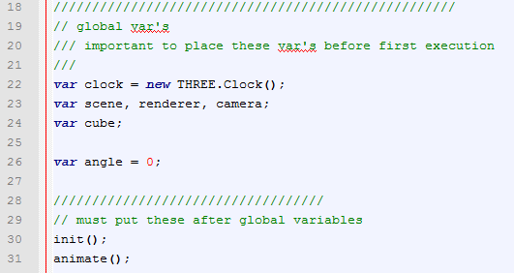
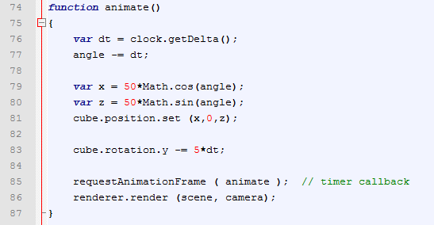
Script (Tuts 1)
Executing the functions

Slide 7
Materials
MeshBasicMaterial: flat shaded or wireframe
MeshLambertMaterial: no specular
MeshPhongMaterial (with bump map)
Later
MeshFaceMaterial
ShaderMaterial

Slide 8
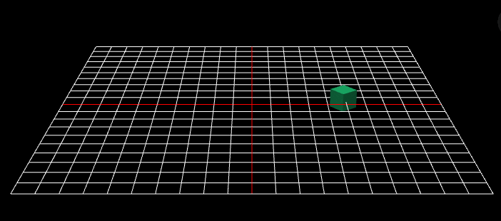
Tuts 1

Slide 9
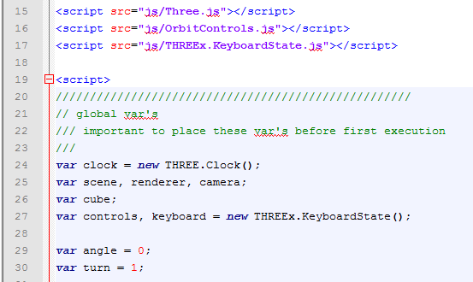
Tuts 2
Add viewer (OrbitControl)
Add keyboard toggle

Slide 10
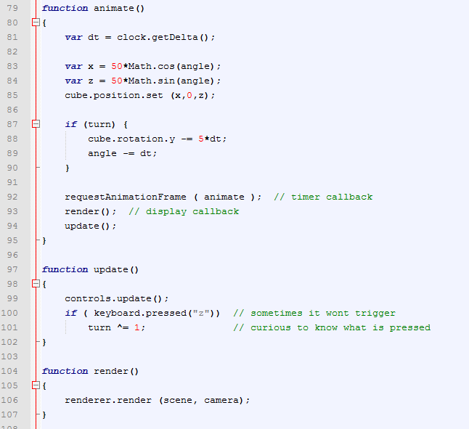
I change to another KeyboardState; it works better

Slide 11
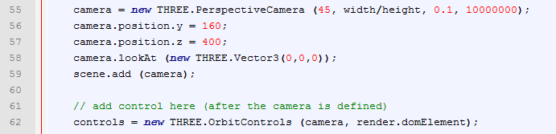
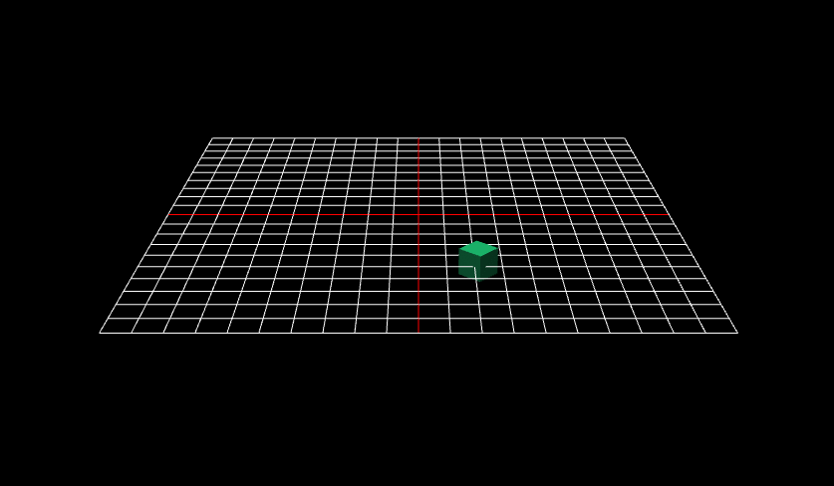

Slide 12
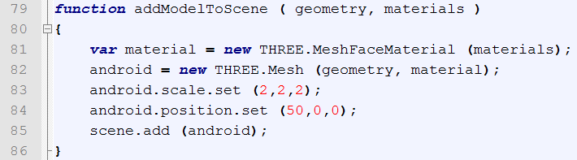
Tuts 3: Loading JSON Model
Twice as large as original size

Slide 13
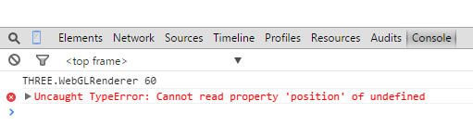
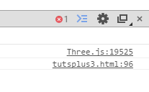
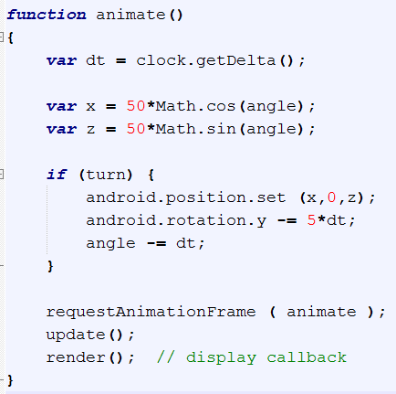
Animate
Android still not ready (“undefined”);
Hence, does not have property of “position”
Solution:

Slide 14
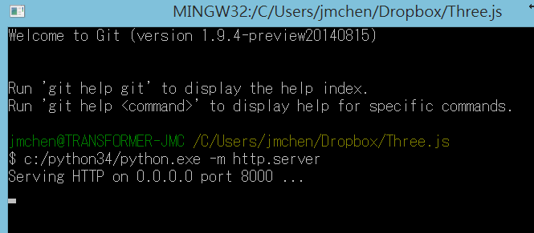
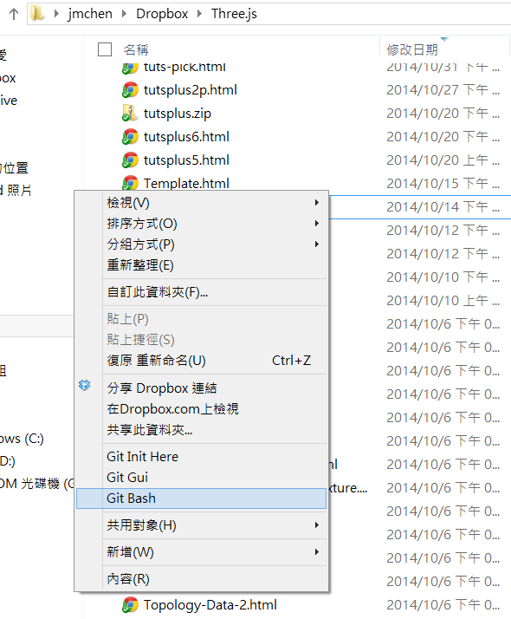
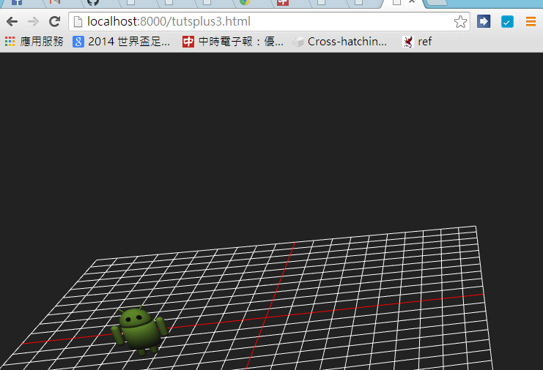
Running this Demo
2. Start http.server with python:
1. Start a bash shell from this directory
3. Load it from localhost:8000

Slide 15
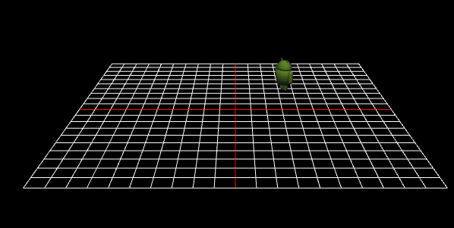

Slide 16
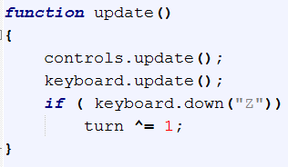
Different KeyboardState.js
Keyboard.pressed (char)
Keyboard.down (char)
Keyboard.up (char)
More sensitive; triggered as soon as the key is down!

Slide 17
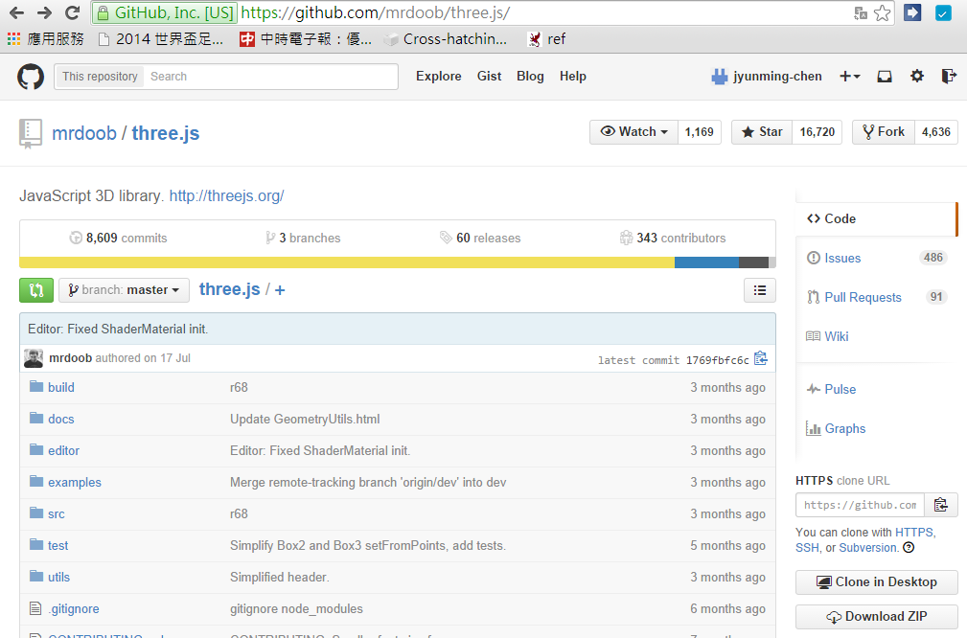
Tuts 4: OBJ Loader
Download loaders from github of three.js (url)

Slide 18
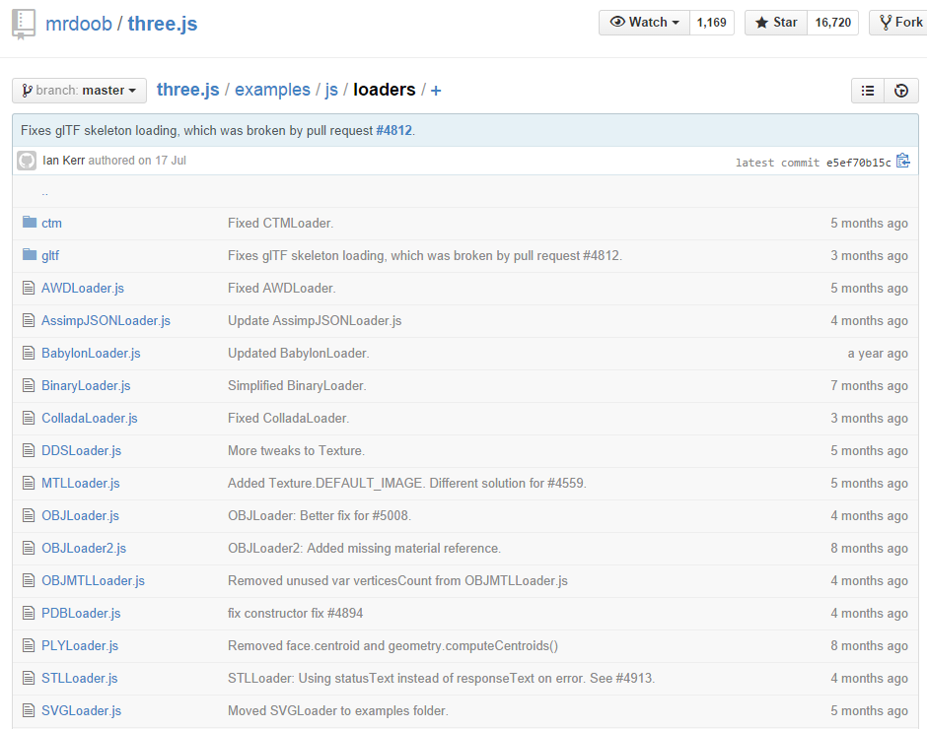

Slide 19
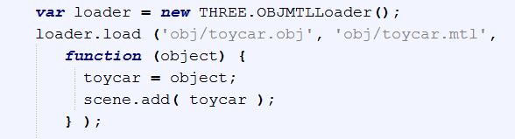
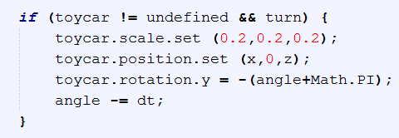
Models are from gluit collection
“inline” callback
Shrink 1/5

Slide 20
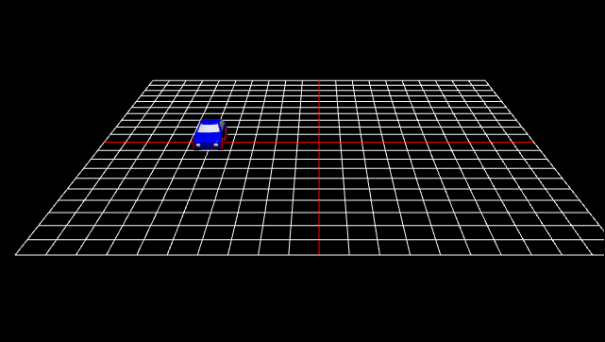
Not ALL OBJs Work!
Loader problems. Choose the one with simpler syntax.
Have not tested models with textures!

Slide 21
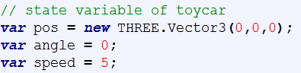
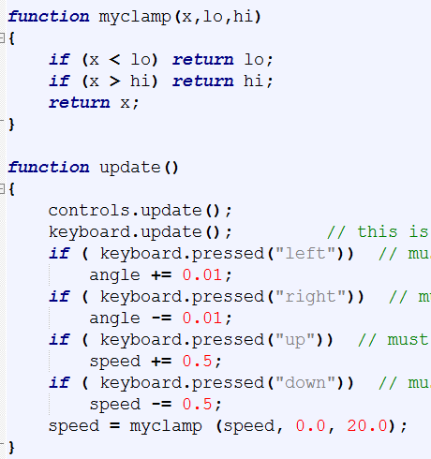
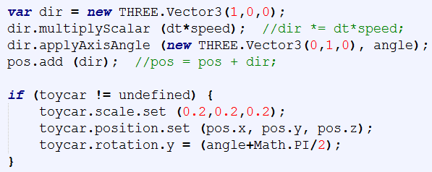
Tuts 5: K-Drive

Slide 22
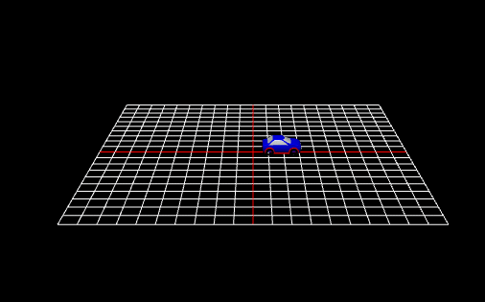

Slide 23
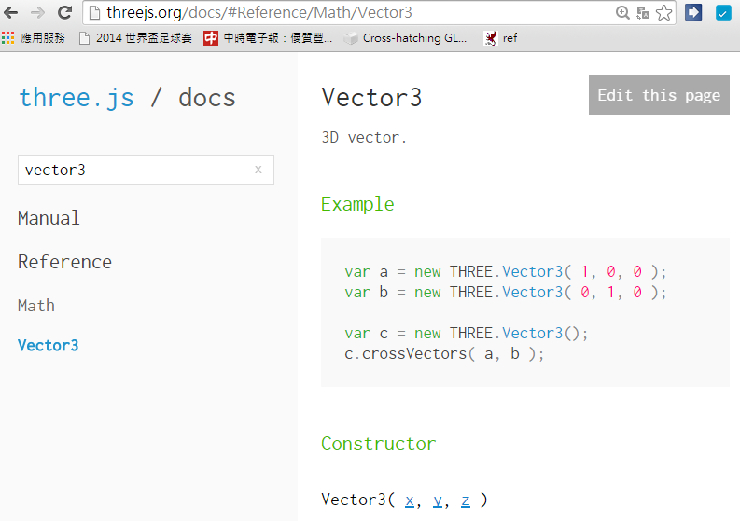
Vector3 documentation

Slide 24
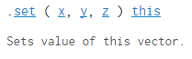
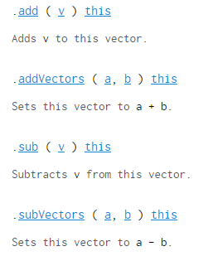
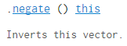
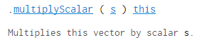
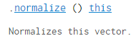
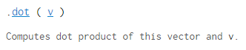
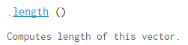
Vector3 API

Slide 25
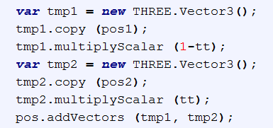
Linear combination: cv + dw
What a pain!

Slide 26
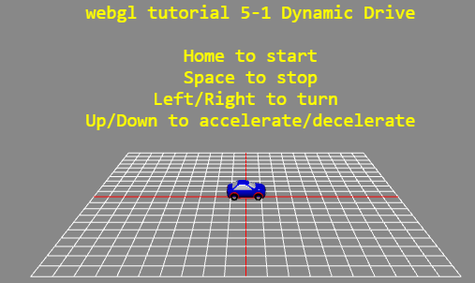
Tuts 5-1 D-Drive

Slide 27
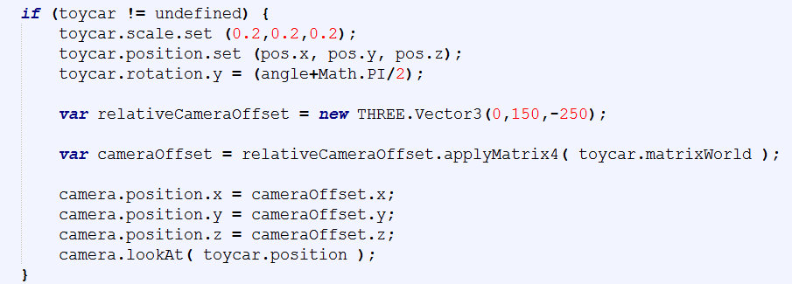
Tuts 6: Drive, 3rd person
Reference: Chase-Camera.html

Slide 28
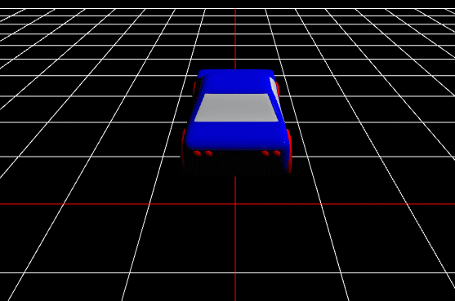

Slide 29
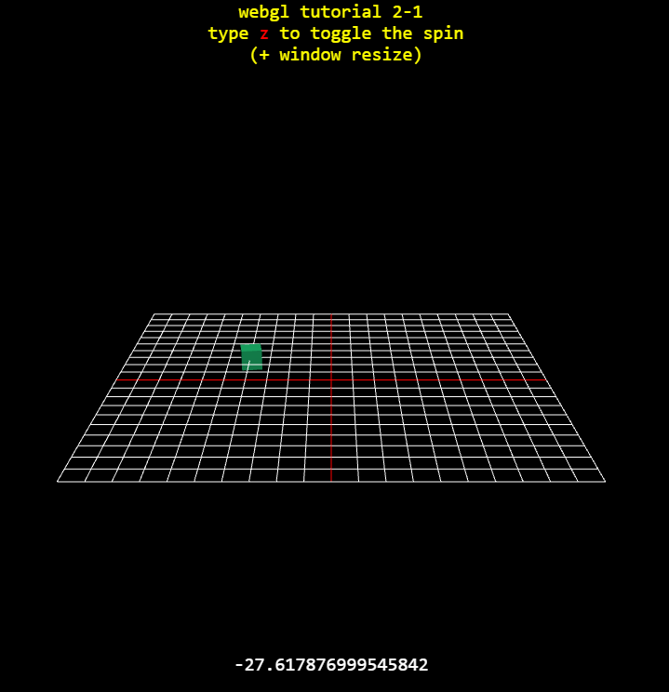
Tuts 2: Hint, resize, style
More sophisticated style

Slide 30
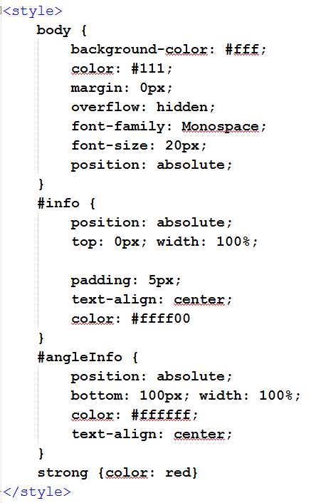
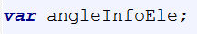
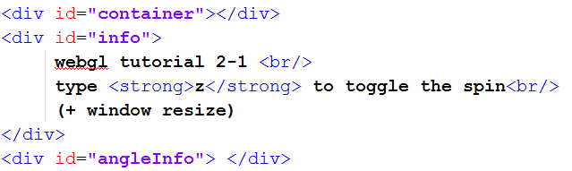
Style

Slide 31
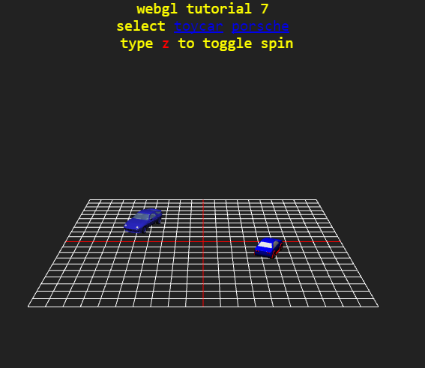
Tuts 7:

Slide 32
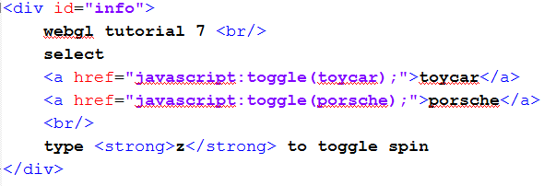
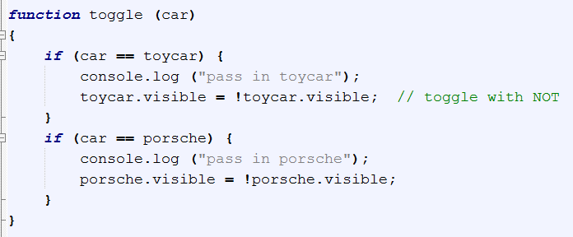
http://stackoverflow.com/questions/14122919/how-to-hide-show-objects-using-three-js-release-54

Slide 33

Tuts 8

Slide 34


Custom geometry
Reference: PlaneGeometry code

Slide 35

Hint from the source of BoxGeometry.js

Slide 36

Tuts 9 Line Style

Slide 37





Line Style
Apply this to grid?!

Slide 38


Not as flexible as glLineStipple
Line width not working:
http://stackoverflow.com/questions/11638883/thickness-of-lines-using-three-linebasicmaterial

Slide 39

jsfiddle
Experiment your style/html
Share to save

